Slide 1
Supervised Learning

Slide 2
How do we know it’s a Banana?
How does a machine know it’s a banana?
How does a machine know it’s a banana?

Slide 3
Using supervised learning to solve problems Predicting the Oscars
How would you frame the Oscar Prediction question?
What type of data would be useful to make predictions?
What steps will you take to process data - before getting started with your analysis.
How would you explore the data?
What type of model(s) will you try?
How will you pick the final model for production?

Slide 4
Classification Vs Regression
Which of these models will you use to solve the Oscar prediction problem? Why?
Is this a supervised or unsupervised learning technique? Why?
How will you validate the results of your model?

Slide 5
Predicting the Oscars with supervised learning Let’s walk through this using the Jupyter Notebook
Notes:
https://github.com/tparveen/DS-instructor-interview

Slide 6
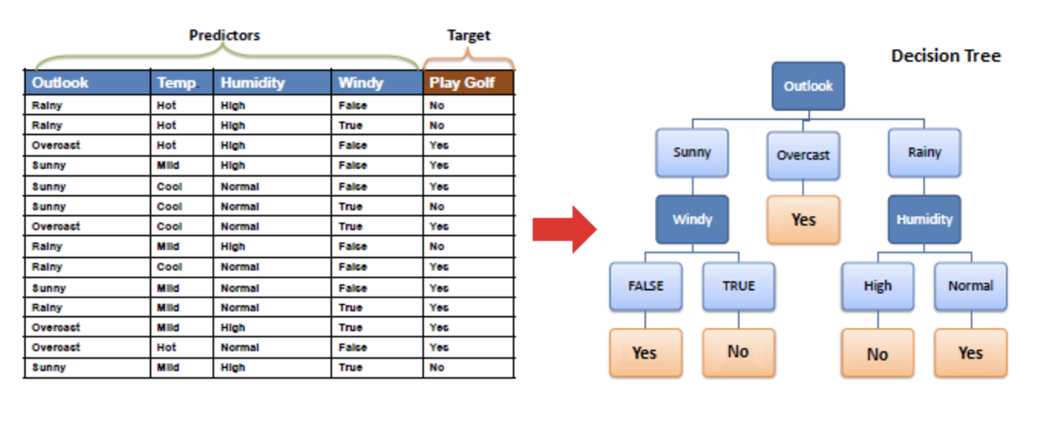
Decision Tree Walk-through
Notes:
Please explain the results of this decision tree.

Slide 7
Problem #1: Poor Predictions
How would you combat poor predictions from your classifier?
Which matrix helps you to decide if a Classification model is working as intended?

Slide 8
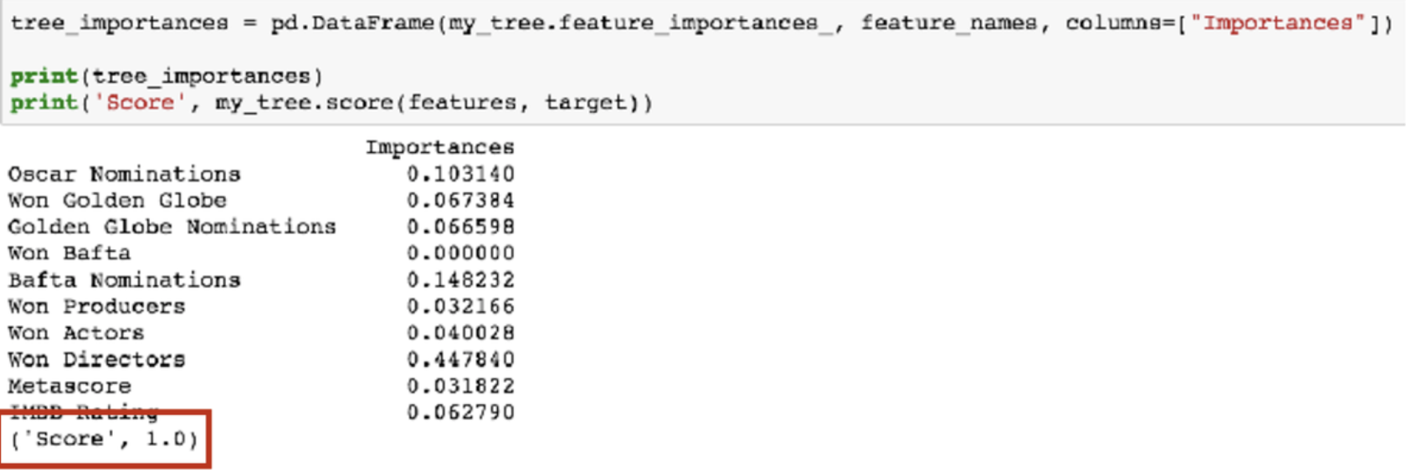
Problem #2: Overfitting
Notes:
Please explain the concept of overfitting. How do you typically combat overfitting in your models?

Slide 9
Solution: Random Forest Classifier
Random Forest Classifiers use many Decision Trees to build classifier
We introduce a bit of randomness
Each Tree can give a different answer (a vote)
The final classification is the most common amongst the trees.

Slide 10
Summary
Supervised learning
Oscar prediction
Decision tree
Problems with our prediction and how to solve them

